Slide 1


Dual Enrollment Success
Disabled Students Programs and Services
May 1, 2026

Slide 2

Navigating Disabled Students Programs and Services at College of the Desert
Transitioning to college courses is both exciting and challenging. Disabled Students Programs and Services (DSPS) is here to ensure equal opportunity and access for students with IEPs, 504 Plans, or other verified disabilities.

Slide 3
Navigating a Fundamental Shift
The Structured Environment (K-12)
The Independent Environment (College)
Parent-led process and advocacy
Guided by IEP and 504 teams
Highly structured daily routines and constant peer/family/school support
Student-led processes and self-advocacy
No IEP or 504 teams; students initiate all DSPS services
Self-guided, less structured learning environment

Slide 4
The Legal Landscape Driving High School vs. College
High School (IDEA and Section 504)
K-12. Ensures student success via Free Appropriate Public Education(FAPE)
Individualized Education Programs (IEPs), specialized instruction, personal aides.
Modifications allowed to curriculum and grade-level requirements
College (ADA and Section 504)
Higher Education. Ensures non-discrimination and equal access to education
Reasonable accommodations providing equal access to college programs.
Modifications strictly prohibited. Students must meet all academic standards.

Slide 5

College Academic Standards
Dual Enrollment
Dual enrollment courses are true college courses. To protect the integrity of your college transcript, course content and requirements cannot be substantially modified.
Not Permitted in College Courses
Shortened or reduced assignments
Flexible deadlines
Re-taking exams due to low scores
Modifications listed on IEPs

Slide 6
Accommodations Provide Equal Access, Not Altered Standards
Instead of changing coursework, DSPS provides tools that change how you access the coursework
Examples of Reasonable Accommodations:
Extended time for exams and quizzes
Accessible learning materials (e.g., text to speech software)
Note-taking software
ASL Interpreting
Priority Registration

Slide 7
What’s Next?
Visit the DSPS New COD Student Checklist for DSPS Students, complete checklist
Timeline for incoming students: Checklist completed by March 1st of Senior Year to qualify for Summer and Fall Priority Registration
Go to class. Attendance is your baseline opportunity to demonstrate what you know.
Keep current with your lectures, assigned readings, assignments, quizzes and exams
Meet at least once per semester with your DSPS counselor to check-in and fine-tune your accommodations
Identify your go-to person for support-the one who grounds you when coursework gets challenging

Slide 8

Student In the Driver’s Seat
In college courses, students are recognized as an independent adult learner. This includes dual-enrollment courses.
Student Responsibilities Include:
Initiating the request for services and providing disability documentation (DSPS accepts IEPs or 504 Plans as verifying documentation of disability)
Leading all communications with DSPS and course instructors
Actively engaging in the interactive process to determine accommodation needs.
Managing accommodations, time, and coursework.

Slide 9
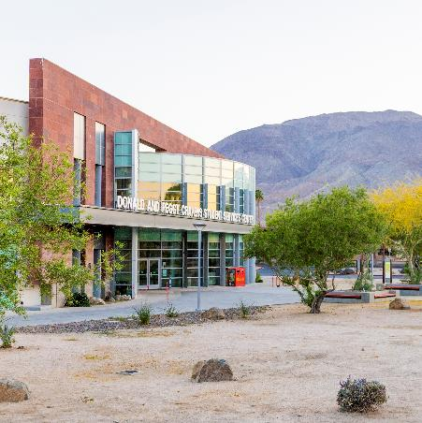
Facilitating Student Success
FERPA
Behind the FERPA Line
Parents as Co-Pilots
Under FERPA, college students (including minors) are legally independent. Parents retain high school rights, but college decision-making shifts entirely to the student.
Only students are permitted to communicate directly with college faculty, request services, or manage DSPS accommodations.
Parents can best support students enrolled in college classes by supporting their independence, helping to gather medical or IEP documents, discussing goals and time management. This is an opportunity for the student to grow in their independence and can help students with transitioning to college.

Slide 10
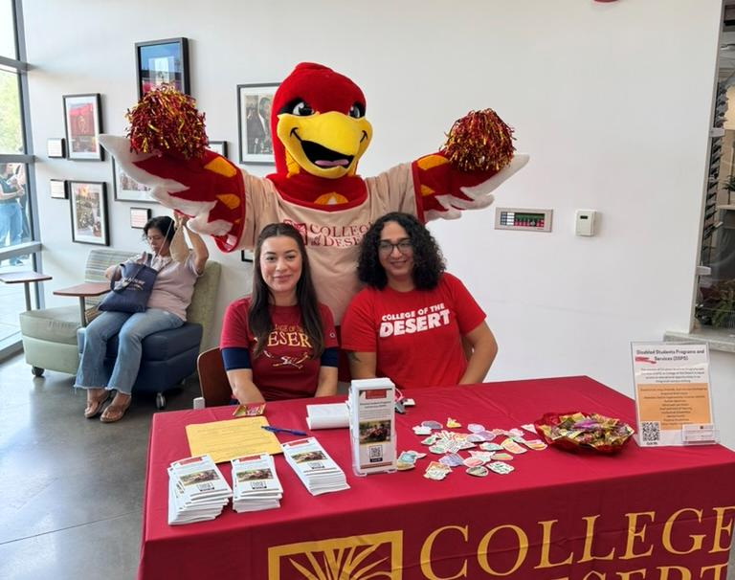
Ask Yourself, Are You Ready?
Skills: Do I have the necessary reading and writing readiness for true college-level coursework?
Advocacy: Am I willing to speak up, manage my own schedule, and communicate directly with DSPS?
Time: Can I effectively manage the independent study hours outside of the classroom?

